Slide 1
Easy, electronic volunteer hour tracking.

Slide 2
Introducing
New way to electronically submit and track your community service hours
Will be the tracking system for both graduation service distinctions and National Honor Society requirements
Platform for advertising school related volunteer opportunities
Will allow students to connect with local organizations and non-profits needing volunteers

Slide 3
Accessing
Mobile and web-based options
www.mobileserve.com
MobileServe is available as a free mobile app in the Google Play and Apple App store and can be used on most smartphones and tablets

Slide 4
First Step: Claim Your Account
You will need access to your UNION email in order to claim the account that has already been created for you.
https://mobileserve.wistia.com/medias/no7ey9n144

Slide 5
In NHS?
Make sure you are a member of both your graduating class and the NHS group
To join additional Groups or if you already have a MobileServe Account:
a. Go to your Settings page.
b. Click on Organizations.
c. Click “Join Organization” and enter the NHS group code: 09789B.
d. When “UHS National Honor Society” pops up, click “Join.”

Slide 6
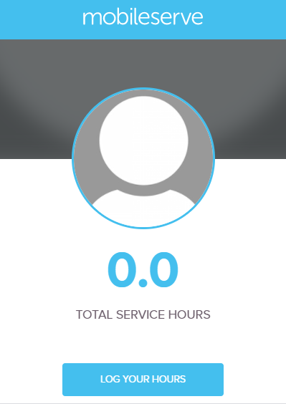
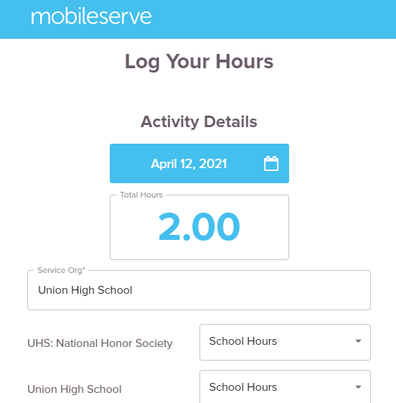
Logging Your Hours
1. On your dashboard, click “Log Your Hours.”
2. Enter the date and number of hours you served.
3. Enter name of the organization you served.
4. Designate your hours as “school” or “non-school” hours.

Slide 7
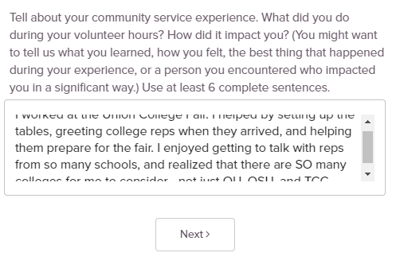
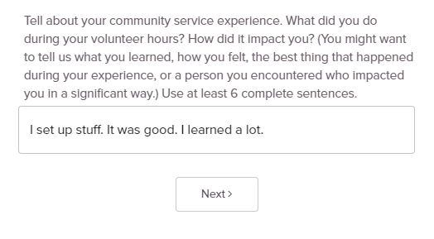
Logging Your Hours
5. Tell us about your community service experience. You must write at least 6 thoughtful, complete sentences.
Good!
Not good!

Slide 8
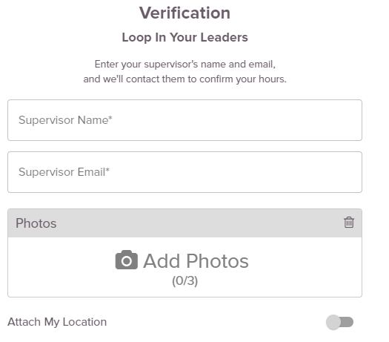
Logging Your Hours: Verification
Web-Based
6. Complete at least 2 of the following options to verify your hours:
Required: enter your volunteer supervisor’s name and email. They will receive an email to verify or not verify your hours.
Options for the 2nd verification:
Get an electronic signature from the volunteer supervisor. (Mobile App only)
Submit photos of your experience.
Attach your location.
Mobile App

Slide 9
Checking Your Hours
Hours that are submitted are not automatically approved.
Students are responsible for checking the Activity Log to ensure that hours have been verified by the volunteer supervisor and approved by Union staff.
If hours are not approved, students may or may not have the opportunity to make corrections and resubmit their hours for approval.

Slide 10
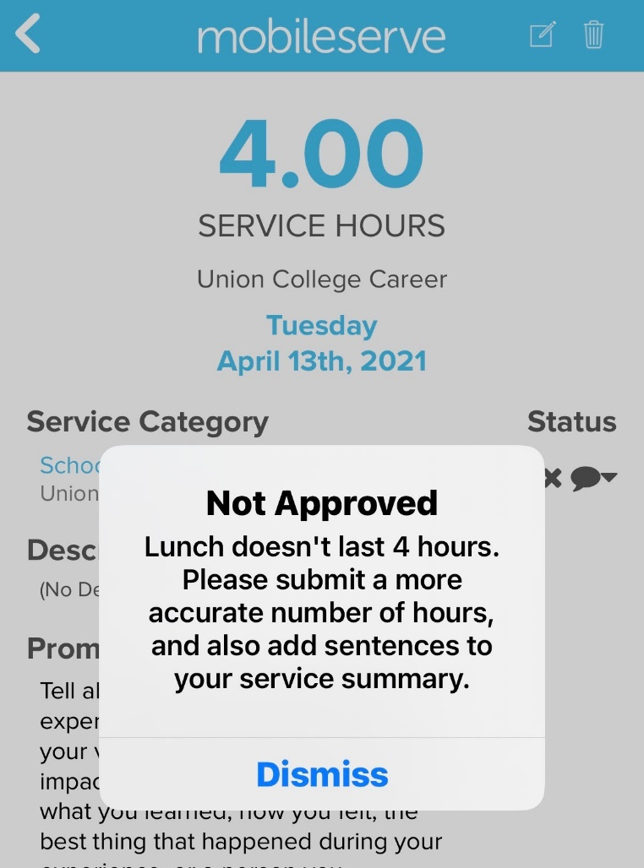
Checking Your Hours
Click the Activity Log to view the status of the hours you have submitted.
No symbol = pending approval
X = hours were rejected, click the entry to learn more
= hours were approved and added to your approved total

Slide 11
F.A.Q.s
Q. What if I don’t remember all of this information?
A. We’ll include these slides, along with other helpful resources in the College/Career Center Canvas course under “Modules.”
Q. When should I start using MobileServe?
A. Right away! We will still accept paper submissions through June 30th, but who wants to do paper-based submissions when you can use Mobile Serve?
Q. Will the hours I submitted on paper be transferred to MobileServe?
A. Yes! But the transfer likely will not take place until the beginning of next school year.

Slide 12
F.A.Q.s
Q. I don’t use a cell phone. How do I record my hours?
A. You can log into your account and record hours on the MobileServe website – www.mobileserve.com.
Q. What are the Community Service and Distinguished Graduate recognition requirements?
A. Community Service recognition requires 200 service hours, including a minimum of 40 school hours. Distinguished Graduate requires 100 service hours, plus academic requirements.
Q. What’s the difference between school hours and non-school hours?
A. Any community service done as a part of a Union event or school can count as school hours. However, hours done during the school day will NOT count for community service hours.

Slide 13
F.A.Q.s
Other questions??

